Slide 1
What is data ?
- In simple word, Data is fact related to any object.
For e.g: your age, job, house no, contact no., name, places are some data related to you.
What is Database ?
- It is systematic collection of data.
e.g : facebook, telecom companies, amazon.com
- Databases supports storage and manipulation of data.
What is DBMS (Database Management System) ?
- It is collection of program enable users to access, create, update, administer and manipulate data.
Types of DBMS :-
1. Hierarchical 2. Network
3. Relational 4. Object Oriented

Slide 2
Relational Database
Relational Databases are the databases that what most of us are all used to. It has been around since the 70's.
Relational Database is like a spreadsheet such as Excel, etc.
A Database consists of tables. For example, Excel is a spreadsheet that consists of a workbook, and inside the workbook, you have different sheets and these sheets are made up of rows and columns.
A row of table is called record.
Each table has its own Primary Key.
A schema (Design of database) is used to define table, columns & relation between table.
Best suited for online transaction processing.
Relational DB are SQL, MySQL, Oracle, PostgreSQL, Aurora etc.
It is usually used in Enterprise Application (except MySQL – for Web Apps)

Slide 3
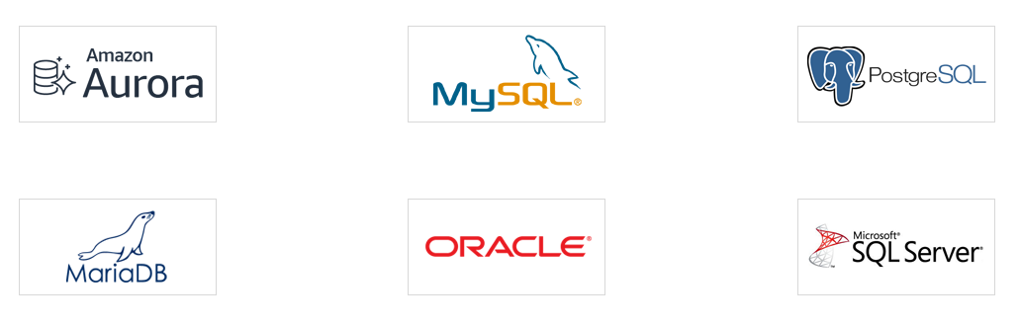
Amazon RDS currently supports the following database engine :
A DB engine is the specific relational database software that runs on your DB instance.

Slide 4
Templates available in RDS :-
Production – Use default for high availability, fast & consistent performance.
Development / Testing – This instance is intended for development use outside of a production environment.
Free Tier – For free tier AWS account.
DB Instance Class Types :-
A DB instance is an isolated database environment in the AWS Cloud. The basic building block of Amazon RDS is the DB instance.
The DB instance class determines the computation and memory capacity of an Amazon RDS DB instance.
Amazon RDS supports three types of instance classes :-
1. Standard Class – M Series [vCPU – 96, RAM-384GB, EBS Througput-14000Mbps
2. Memory Optimized Class – R & X Series [vCPU – 96, RAM-768GB, EBS Througput-14000Mbps]
3. Burstable Class – T Series [vCPU – 8, RAM-32GB, EBS Througput-1500Mbps]

Slide 5
RDBS Instance Storage comes in the following types :-
1. General Purpose – Use for DB workloads with moderate I/O requirements.
Min.- 20GB Max. – 16384GB
2. Provisional IOPS – Use for high performance like OLTP workloads.
Min. – 100GB Max.- 16384GB
There are two types of licensing option :-
1. BYOL (Bring Your Own License) – If you have already license
2. License from AWS [Charge Hourly]
RDS Limits :
Maximum 40 DB instance can be created per account.
10 out of 40 can be Oracle or MySQL Server under License included model
Under BYOL model, all 40 can be any DB engine you need

Slide 6
Amazon RDS provides the following purchasing options :
1. On-Demand Instances –
Pay by the hour for the DB instance hours that you use.
Pricing is listed on per-hour basis, but bills are calculated down to the second and show times in decimal form.
RDS usage is now billed in one second increments, with a minimum of 10 minutes.
2. Reserved Instances –
Reserve a DB instance for a one-year or three-year term and get a significant discount compared to the on-demand DB instance pricing.
With Reserved Instance usage, you can launch, delete, start, or stop multiple instances within an hour.

Slide 7
In an AWS fully managed Relational DB engine services, AWS is responsible for :-
Security, Patching & Automated Back-Up
Software update for the DB engine
By default, Every DB has weekly maintenance window. [Range = 1 to 35 days]
Automatic failover if Multi-AZ is selected with Synchronous Replication between the active and Standby DB instances.
Setting Managed by User :-
Managing DB setting
Creating Relational DB Schema
Database Performance Tuning

Slide 8
RDS Billing :
No up front cost.
You have to pay only for :
> DB Instance > Storage GB/month
> Backup Storage (S3) > Internet data transfer
AWS also charge for :
Multi-AZ DB hourly
Provisioned storage (Multi-AZ)
You are not charged for DB data transfer during replication from primary to standby.

Slide 9
Lab1 : How to access MySQL DB instance from Linux
Go to Services > Search RDS > Create Database
DB creation method – Standard create, Engine option – MySQL
Template – Free-tier, Set master password – abc123456
DB Instance Size – Burstable class, Storage – General Purpose
Uncheck Storage Autoscaling, Multi-AZ- No
Select Default VPC, Publicly Access – Yes, Create New Security Group (RDS-SG)
Click on Additional Configuration > Enter DB Name
Disable Backup > Disable Delete Protection > Create DB
Click on DB > Go to Security Group > Inbound Rule > Edit Inbound Rule > Add Rule > Allow Port SSH
Launch Linux EC2 Instance [Select Security Group that was created at the time of RDS] > Access EC2
Login as : ec2-user & then enter – sudo su –
Now, dnf install mysql [Go to RDS, copy Endpoint from RDS & paste after mysql –h]
mysql -h database-1.cnqdy3woque0.us-east-1.rds.amazonaws.com -u admin(Master Username) -p db1(DB Name)
    Enter password

Slide 10
Lab2 : How to access MySQL DB instance from Windows Server
Follow the previous step to create database.
Allow HTTP, HTTPS & RDP in security group.
Launch EC2 & take RDP.
Go to Server Manager > Local Server
Turn Off ‘Windows Defender Firewall’ & ‘IE Enhanced Security Configuration’
Go to Internet Explorer > Google > Install Web Platform Installer
Start > MS Web Platform Installer > Application > Search MySQL > Add
Enter Password > I Accept > Install > Finish > Exit
Go to CMD – [Copy Endpoint from RDS & paste after mysql –h]
mysql -h database-1.cnqdy3woque0.us-east-1.rds.amazonaws.com -u admin(Master Username) -p db1(DB Name)
    Enter password

